Slide 1
Interfaces and abstract class in java

Slide 2
Abstract classes
Abstraction : Only essential data will be shown to user. The properties and behavior will be differentiated form the user.
In Java, we have abstract classes and methods.
abstract class <class_name>{
// declare variables
abstract <return_type> <method_name>(<paramteres>);
}

Slide 3
Features of Abstraction
It reduces the complexity of viewing the things.
Avoids code duplication and increases reusability.
Helps to increase security of an application or program as only important details are provided to the user.

Slide 4
Interfaces
Interfaces specify what a class must do and not how. It is the blueprint of the class.
For Example : An Interface is about capabilities like a Player may be an interface and any class implementing Player must be able to (or must implement) move(). So it specifies a set of methods that the class has to implement.
If a class implements an interface and does not provide method bodies for all functions specified in the interface, then class must be declared abstract.
A Java library example is, Comparator Interface. If a class implements this interface, then it can be used to sort a collection.

Slide 5
Interfaces
interface <interface_name> {
// declare constant fields
// declare methods that abstract
// by default.
}
Example :
Interface Shape {
public abstract draw();
}
Class Square implements Shape {
public abstract draw(){
S.O.P(“Inside Square Class”);
}
}

Slide 6
Features of Interfaces
Default()
Private methods inside default()
Static methods
Private Static methods

Slide 7
Features of Interfaces
Static method in interfces
interface <interface_name> {
// declare constant fields
// declare methods that abstract
// by default.
default static <return_type> <method_name>(){
//default implementation
}
}

Slide 8




Case study
Shopping cart

Slide 9
Why do we use interface ?
It is used to achieve total abstraction.
Since java does not support multiple inheritance in case of class, but by using interface it can achieve multiple inheritance .
It is also used to achieve loose coupling.
Interfaces are used to implement abstraction.

Slide 10
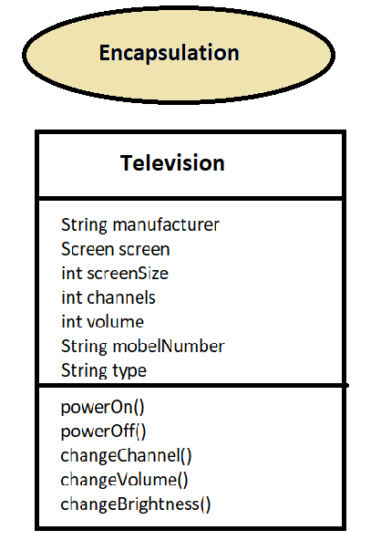
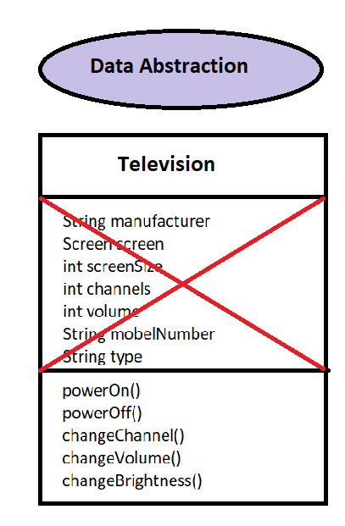
Encapsulation v/s data abstraction

Slide 11
Summary
We can’t create instance(interface can’t be instantiated) of interface but we can make reference of it that refers to the Object of its implementing class.
A class can implement more than one interface where as it can extend abstract class at once.
An interface can extends another interface or interfaces (more than one interface) .
A class that implements interface must implements all the methods in interface else it will be declared as abstract class.
Methods can be private, public, default and abstract. And all the fields are public, static, and final.
It is used to achieve multiple inheritance.
It is used to achieve loose coupling.

Slide 12

Case Study 2

Slide 13
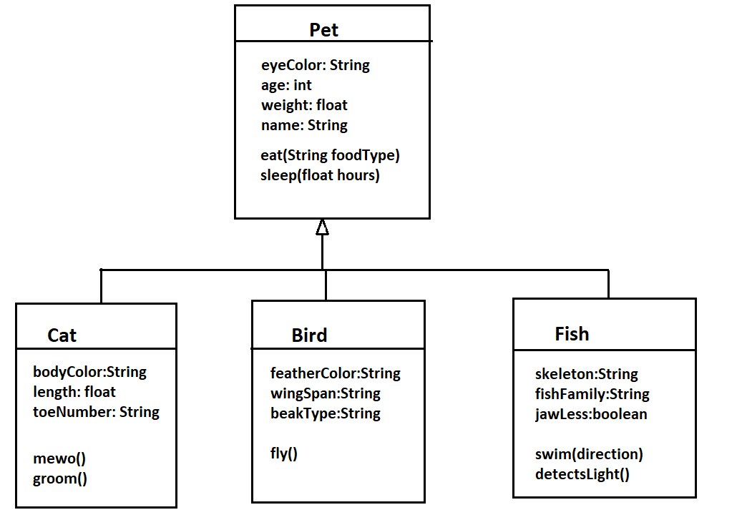

Implementation
Base class : Pet
Child class : Cat, Bird, Fish

